Slide 1
System Development Methods CT00046-3-2
System Analysis – Part 1

Slide 2
Topic & Structure of the Lesson
System analysis and data analysis
Activities of systems analysis
System requirements

Slide 3
Learning Outcome
At the end of the module, you should be able to:
Define system analysis and data analysis.
Describe the activities of systems analysis.
Discuss the various requirements in a system specification.

Slide 4
Key Terms you must be able to use
If you have mastered this topic, you should be able to use the following terms correctly in your assignments and exams:
System analysis and data analysis.
Activities of systems analysis
System requirements

Slide 5
System analysis and data analysis.

Slide 6

System Analysis and Data Analysis
System Analysis
Systems analysis is a problem-solving technique
Decomposes a system into its component pieces for purpose of the studying how well those component parts work and interact to accomplish their purpose
Involves Data Gathering, Data Analysis, Creating Specification
Data Analysis
A process of inspecting, cleaning, transforming, and modeling data to discover useful information, suggesting conclusions, and supporting decision-making.

Slide 7

Data Analysis Process
Collecting and storing data
Cleaning data
Analyzing data
Creating output information
Conclusion of analysis
System Specification

Slide 8
Data Analysis Process (continued)
Data Collection and Compilations
Collect and merge data from different sources
Data Cleaning
Removing errors invalid data , redundancy, empty / incomplete data
Data Analysis
Looking for relations and patterns within/between data
Data Visualization/Creating Output
Presenting data in the tabular, graphical, chart, etc.
Conclusions
Result of analysis.
Helps in creating System Requirements Specifications (SRS)

Slide 9
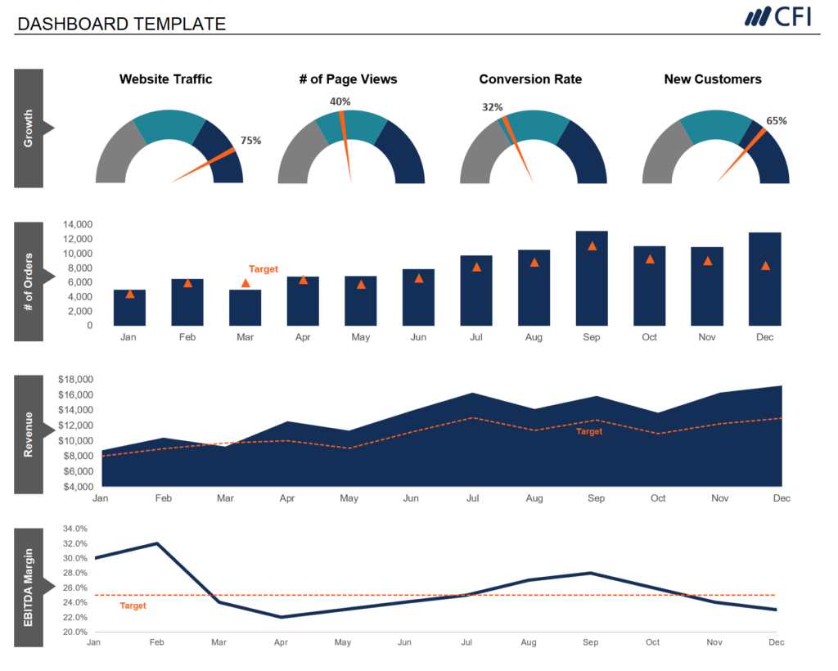
Output of Data Analysis
New knowledge
Summary Table / Charts
Final Facts and Figures
Conclusion
System Requirements
Specifications (SRS)

Slide 10
Activities of systems analysis

Slide 11
Systems Analysis Activities
Gather Detailed Information
Interviews, questionnaires, documents, observing business processes, researching vendors, comments and suggestions
Define Requirements
Modeling functional requirements, non-functional requirements, etc.
Prioritize Requirements
Essential, important, vs. nice to have
Develop User-Interface Dialogs
Flow of interaction between user and system
Evaluate Requirements with Users
User involvement, feedback, adapt to changes

Slide 12
Systems Analysis Activities Gather detailed information
Systems analysts obtain information from people who will be using the system, either by interviewing them or by watching them work, reviewing planning documents and policy statements, study existing systems, including their documentation (use of requirement gathering techniques).
They try to understand an existing system by identifying and understanding activities of all the current and future users by identifying all present and future locations where work occurs and all system interfaces with other systems, both inside and outside the organization.
The analyst must become an expert in the business area the system will support. For example:
If you are implementing an order-entry system, you need to become an expert on the way orders are processed (including related accounting procedures).
If you are implementing a loan-processing system, you need to become an expert on the rules used for approving credit.

Slide 13
Systems Analysis Activities Define requirements
The analyst uses information gathered from users and documents to define requirements for the new system.
System requirements include the functions the system must perform (functional requirements) and such related issues as user interface formats and requirements for reliability, performance, and security (non-functional requirements).
Further system requirements are discussed in the next section.
The analyst creates models to record requirements, reviews the models with users and others, and refines and expands the models to reflect new or updated information.

Slide 14
Relationship Between Information Gathering and Model Building
Interviews
understanding
Questionnaires
New System Constraints
Reviewing existing inputs/outputs
Requirements Definition and Models for New System
Business Procedures
Observing business procedures
Information gathering
Researching Vendor Solutions
Required Functionalities
Collecting Feedback on Prototypes

Slide 15
Reasons for Modeling
Learning from the modeling process
Reducing complexity by abstraction
Remembering all the details
Communicating with other development team members
Communicating with a variety of users and stakeholders
Documenting what was done for future maintenance/ enhancement

Slide 16
Systems Analysis Activities Prioritize requirements
Once the system requirements are well understood, it is important to establish which requirements are most crucial for the system. Sometimes, users request additional system functions that are desirable but not essential.
Why prioritize the functions requested by the users?
Resources are always limited, and the analyst must always be prepared to justify the scope of the system.
Therefore, it is important to know what is absolutely required. Unless the analyst carefully evaluates priorities, system requirements tend to expand as users make more suggestions (a phenomenon called scope creep).

Slide 17
Systems Analysis Activities Prioritize requirements (continued)
Requirement priorities also help to determine the number, composition, and ordering of project iterations. High-priority requirements are often incorporated into early project iterations, so analysts and users have ample opportunity to refine those parts of the system.

Slide 18
Systems Analysis Activities Develop user-interface dialogs
In some cases, when a new system is replacing an old system that does similar work, users are usually quite sure about their requirements and the desired form of the user interface.
In other cases, the system development project breaks new ground by automating functions that were previously performed manually, or by implementing functions that were not performed in the past.
In either case, users tend to be uncertain of many aspects of system requirements.
Developing user-interface dialogs is a powerful method of eliciting and documenting requirements. Analysts can develop user interfaces via abstract models, storyboards or user-interface prototypes on the actual input/output devices that users will use. A user-interface prototype can be expanded in later iterations to become a fully functioning part of the system.

Slide 19
Systems Analysis Activities Evaluate requirements with users
Ideally, evaluating requirements with users and documenting the requirements are fully integrated. But in practice, analysts usually use an iterative process in which they elicit user input to model requirements, return to the user for additional input or validation, and then work alone to incorporate the new input and refine the models.
The processes of eliciting requirements, building models and prototypes, and evaluating them with users may repeat many times until requirements models and prototypes are complete and accurate.

Slide 20
System requirements

Slide 21
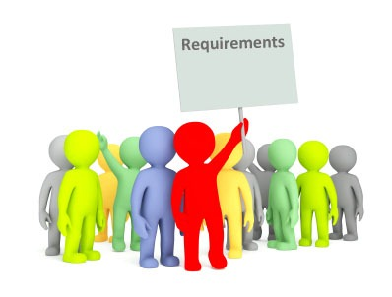
System Requirements Specification (SRS)
System requirements specification (SRS) is the finalized output of system analysis.
Contains requirements of the system to be built.
System requirements are all the activities the new system must perform or support and the constraints that the new system must meet. Mainly contains various System Requirements such as:
Functional Requirements
Non-Functional Requirements
Technical Requirements
Security Requirements
Interface Requirements
User Requirements
Business Requirements, etc.

Slide 22
System Requirements
Functional requirements
Activities system must perform (use cases)
Based on procedures and business functions
Documented in analysis models
Nonfunctional requirements
Technical environment or performance objectives
Usability, reliability, and security requirements

Slide 23
FURPS+ Requirements Acronym
System Requirements
(continued)

Slide 24
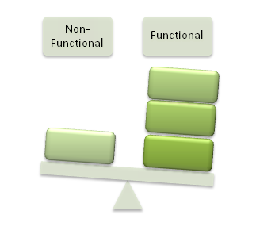
Functional Requirements
The vital function of a system and its components.
Described as a set of inputs, the behavior that the system is supposed to accomplish.
Defines ‘WHAT’ the system is supposed to do.
Main calculations that need to be performed
Technical details need to be included
Data manipulation and processing
Examples:
A system shall send an email whenever a certain condition is met (e.g., an order is placed, a customer signs up, etc.).
A system shall apply a discount for orders above RM100

Slide 25
Non-Functional Requirements
Nonfunctional requirements are characteristics of the system other than those activities it must perform or support.
Define ‘HOW’ a system is supposed to be.
Often concerns the qualities of a system which defines in measurable units: technical, performance, usability, reliability, etc.
Technical Requirements
Hardware and software requirements
Workload requirements- throughput, response time
Usability Requirements
user interface
work procedures
online help and documentation.
Reliability Requirements
Security requirements
Performance Requirements
Dependability of the system
Describe which users can perform what system function under what condition.
Service outage
System recovery.

Slide 26

Technical Requirements
Hardware / Software / Environment requirement for the new system to run on.
Often included / merged with Non-Functional Requirement (but better to separate)
Examples:
System should run a Windows Server 2010 and above
The core system should have a minimum of 4GB of RAM.
A mobile application might be required to use the Android operating system, consume no more than 30 MB of flash memory storage.
Software needs such as OS, applications, plug-ins, etc.
Networking needs such as bandwidth, protocols etc.

Slide 27
Performance requirements
Performance requirements describe operational characteristics related to measures of workload, such as throughput and response time. Example:
The client portion of a system might be required to have a 0.5 second response time to all button presses, and the server might need to support 100 simultaneous client sessions (with the same response time).

Slide 28
Usability requirements
Usability requirements describe operational characteristics related to users. Examples:
The smartphone application should behave similarly to other apps when responding to such gestures as two-finger slides, pinching, and expanding.
Related work procedures
Online help and documentation
Multilanguage support

Slide 29
Reliability requirements
Reliability requirements describe the dependability of a system — how often a system exhibits such behaviors as service outages and incorrect processing and how it detects and recovers from those problems.

Slide 30
Security Requirements
Describe how access to the application will be controlled and how data will be protected during storage and transmission.
Examples:
The application might be password protected, encrypt locally stored data with 1024-bit keys.
Use secure HTTP for communication among client and server nodes.

Slide 31
Interface Requirements
Describe interactions among systems.
Examples:
A financial reporting system for a publicly-traded company in the United States must generate data for the Securities and Exchange Commission (SEC) in a specific XML format.
The system might also supply data directly to stock exchanges and automatically generate Twitter messages, RSS feeds, and Facebook updates.

Slide 32
User Requirements
Special requirements from users, for personal benefits.
Often not a high priority but developed when the developer has enough time/budget.
Examples:
Users should be able to print their profiles from the system.
Users should be able to customize the background of the desktop.

Slide 33

Business Requirements
Requirements that needed to be included in the system for the benefit of the company’s business
Comes from the system owners or stakeholders.
Aligns with the company vision & mission, business goals, and objectives
Examples:
The web-based system should support the business growth for the next five years.
The system should be flexible to support corporate merger in another 3 years time.

Slide 34
Summary
System Analysis decomposes a system into some components and studies how well those components work and interact to accomplish their purpose. It involves Data Gathering, Data Analysis, Creating specifications.
Data analysis involves data collection and compilations, data cleaning, data analysis, Looking for relations and patterns within/between data, data visualization, and providing final conclusions.
Systems analysts obtain information from people who will be using the system, define system requirements, set a priority, and evaluate the requirements with users.
Functional requirements describe activities the system must perform and are based on procedures and business functions.
Non-Functional requirements describe the technical environment, performance objective, usability, reliability, and security requirements.

Slide 35
Question & Answer

Slide 36
Next Session
System Analysis Part 2

